Slide 1

PROFILE PAGE APPLICATION
PRESENTING BY:
G.SHRUTHIKA
J.RAMESH
A.YAMUNA DEVI
K.DURGA PRATIMA
G.AKASH SAI
TRAINER:
JAVEED MOHAMMED HUSNUDDIN SIR

Slide 2

ABOUT PROJECT
A profile page represents information regarding a user's identity on a website or in a mobile app. It may contain personal data, a profile photo and etc.
Here in our project we have implemented three microservices in backend for respective usage in the application.
When it comes to frontend we used reactjs to create user interface.

Slide 3
Admin crud operations
PROJECT VIEW
Post crud operations
ADMIN
User crud operations
USER
Register
Login
Post image
Message
MESSAGE
Common component in user and admin for connecting with people

Slide 4
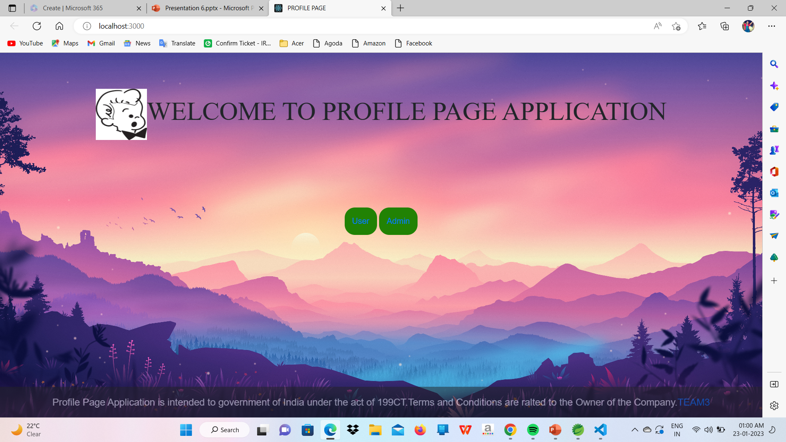
UI PAGE
User and Admin will be able to see this page before login or register as user and admin.
By clicking the user button will redirect to user page where it contains login and register things
When it comes to admin the operations are same as listed like login and register
After registration and methods will be able the pages respective to login credentials

Slide 5
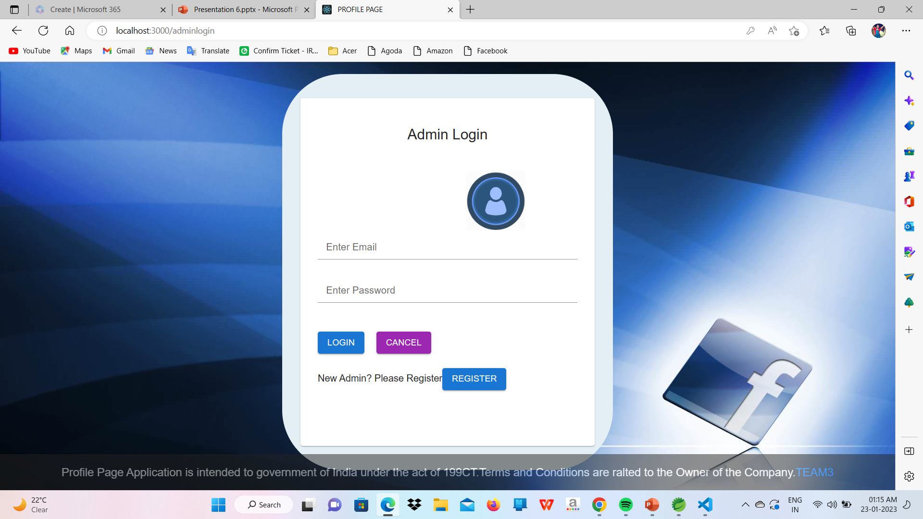
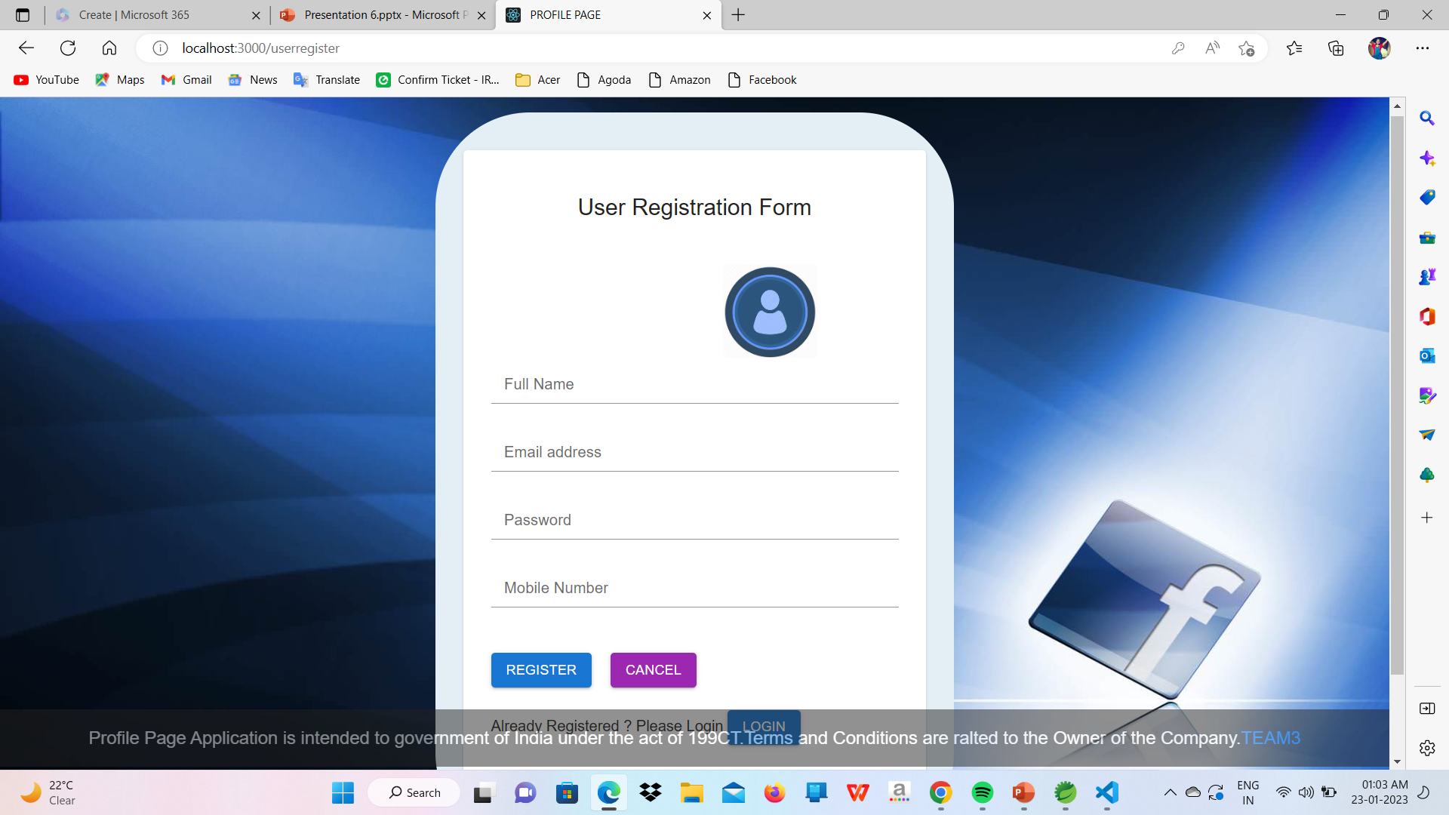
LOGIN AND REGISTER PAGE
Once the user or admin button is clicked in the main page
Login and registration pages will open based on the option which is clicked in the main page

Slide 6
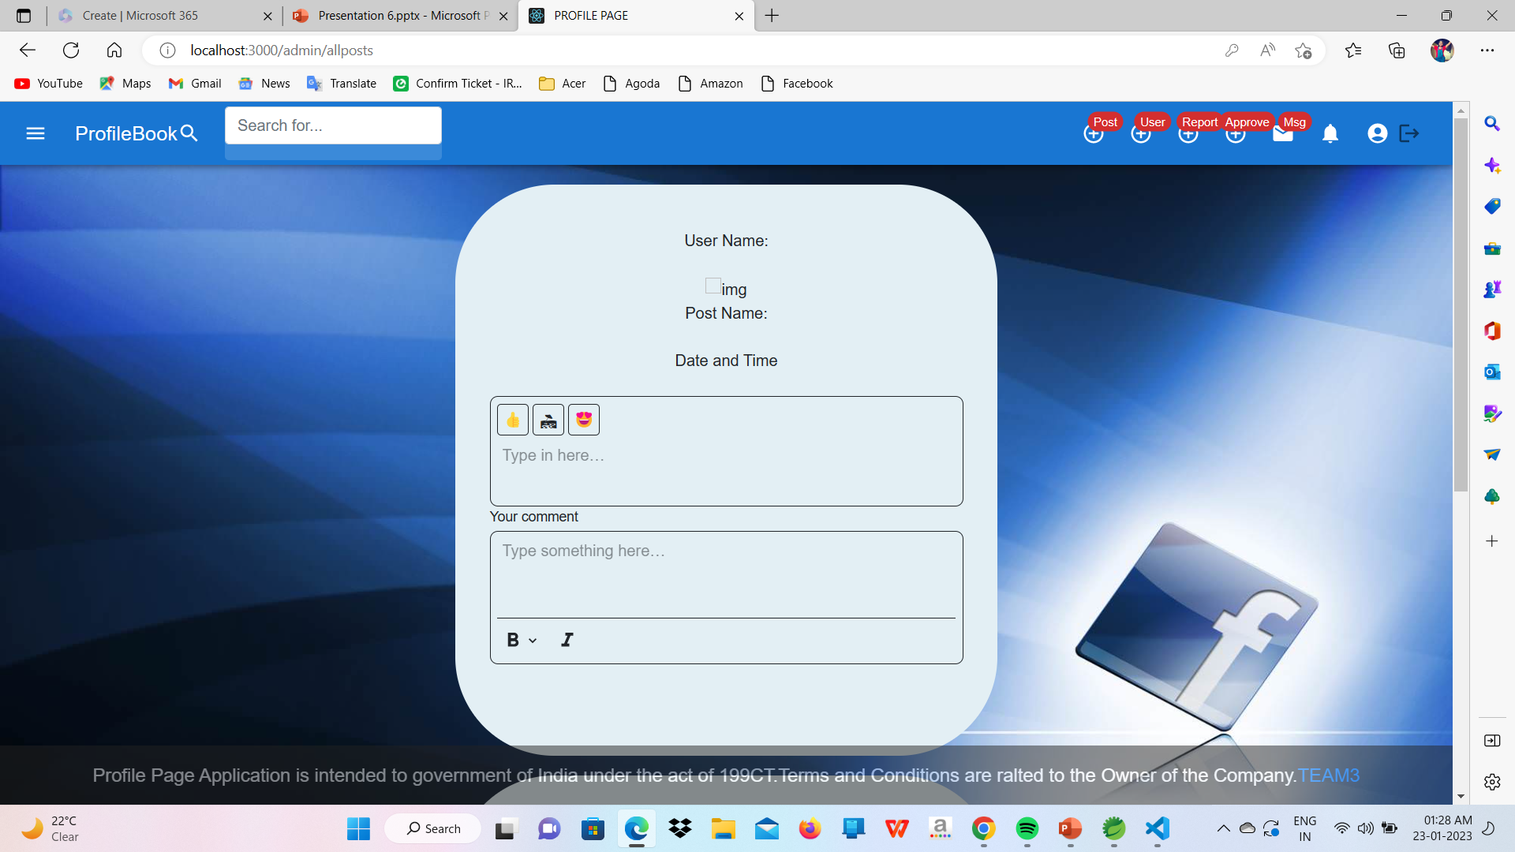
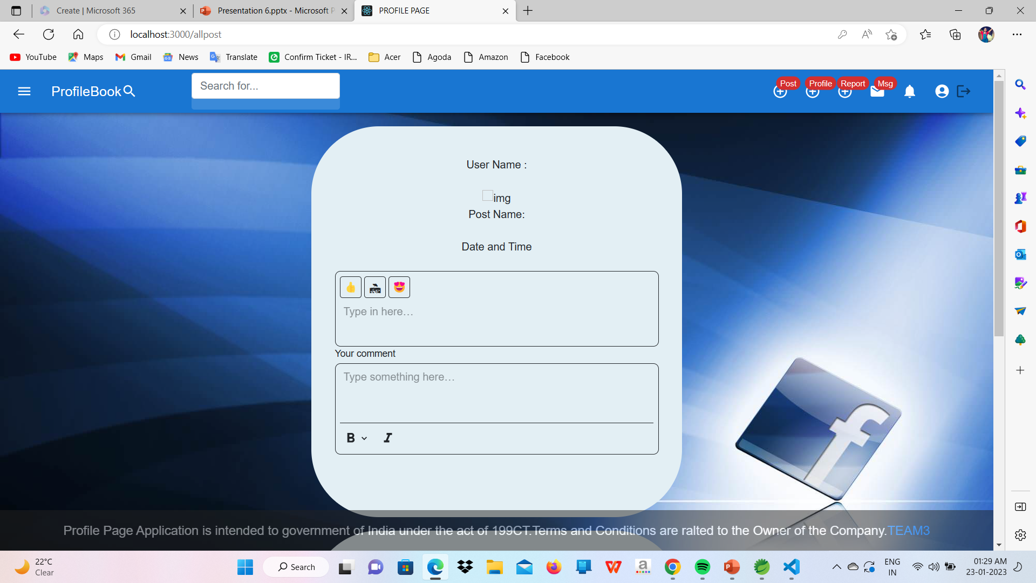
USER AND ADMIN VIEW
ADMIN PAGE VIEW
USER PAGE VIEW
After login with credentials as user or admin .
The user can see the next page with required operations and in the same way admin can see operations which admin can do.

Slide 7
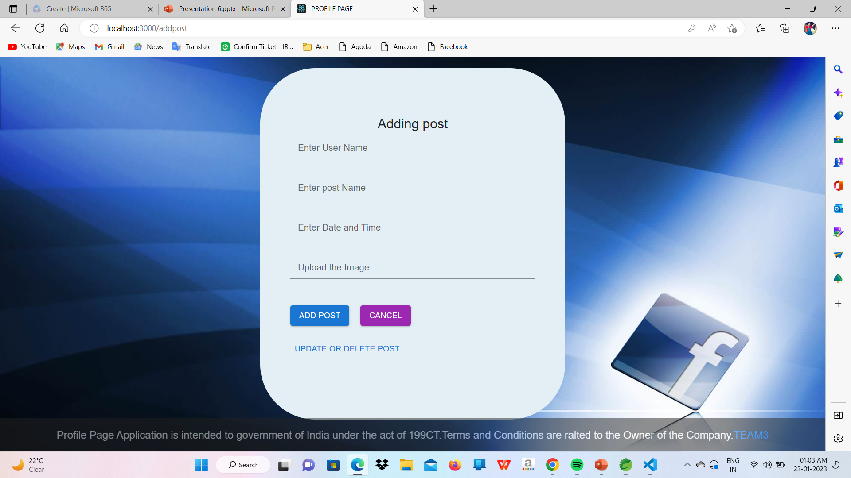
POST PAGE
Adding a post operation can be done by both user and admin.
But the posts which are posted by the user should be approved by the admin whereas the posts posted by the admin doesn't need any approval

Slide 8
TECHNOLOGIES
The technology that we used to develop our backend is "springboot".
Here in this spring we added dependencies like springWeb,lombok and etc based on the requirement in the project.
The technology that we used to develop our frontend is "reactjs".
Here in this react we installed packages like router,axios and etc according to the functionality of the application

Slide 9
CONCLUSION
We developed a application which is similar to social media application like facebook,instagram etc..,where we post the images,connect with the people through messages.
Similar to facebook admin in our application admin perform the operations on the post,users in order to have an efficient appplication in terms of all the things.

Slide 10


Slide 11


